Slide 1
Strategic Prospecting and Preparing for Sales Dialogue
5

Slide 2
Learning Objectives
L
1
Discuss why prospecting is an important and challenging task for salespeople.
Explain strategic prospecting and each stage in the strategic prospecting process.
Describe the major prospecting methods and give examples of each method.
L
2
L
3

Slide 3
Learning Objectives
L
4
Explain the important components of a strategic prospecting plan.
Discuss the types of information salespeople need to prepare for sales dialogue.
L
5

Slide 4
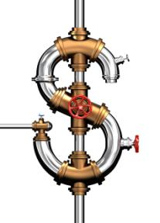
The Importance and Challenges of Prospecting
Customer-bases are not permanent, salespeople may lose customers due to:
Low satisfaction
Competition
Economic fluctuation
Other forms of attrition
The prospecting process is can be long
It may take weeks to replace a lost customer with a new one
Revenue streams can fluctuate if “pipeline” isn’t managed
Prospecting isn’t easy and often includes a lot of rejection

Slide 5
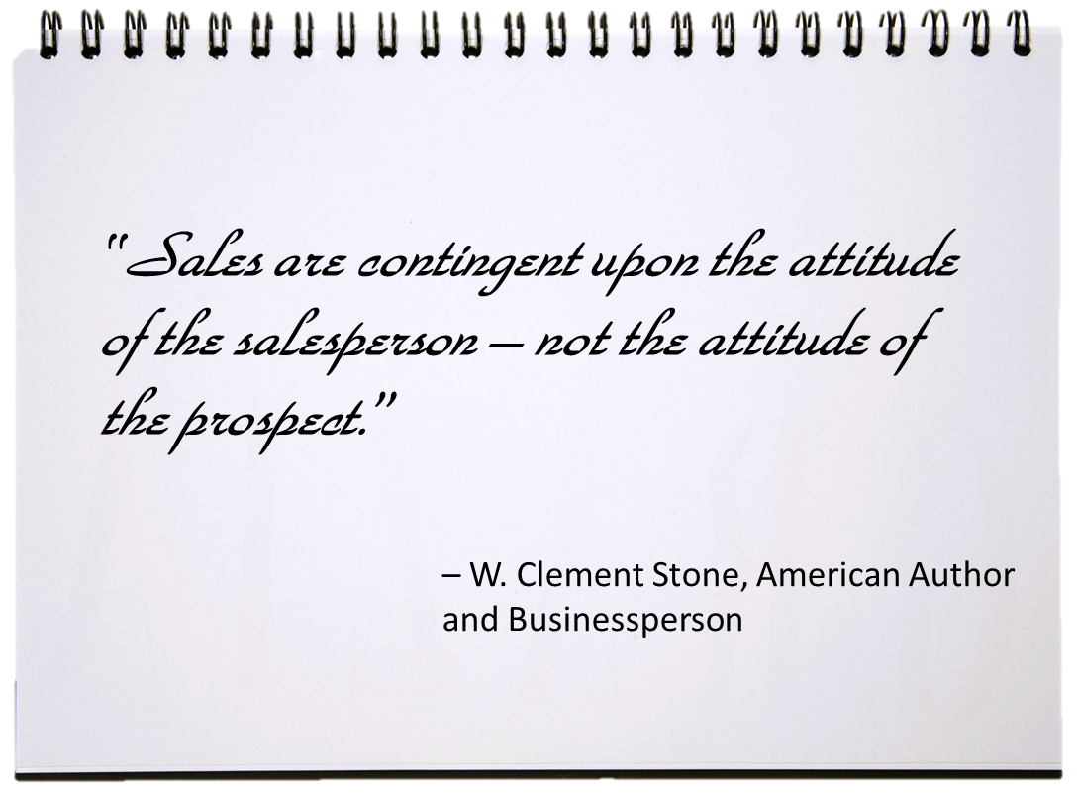

Slide 6
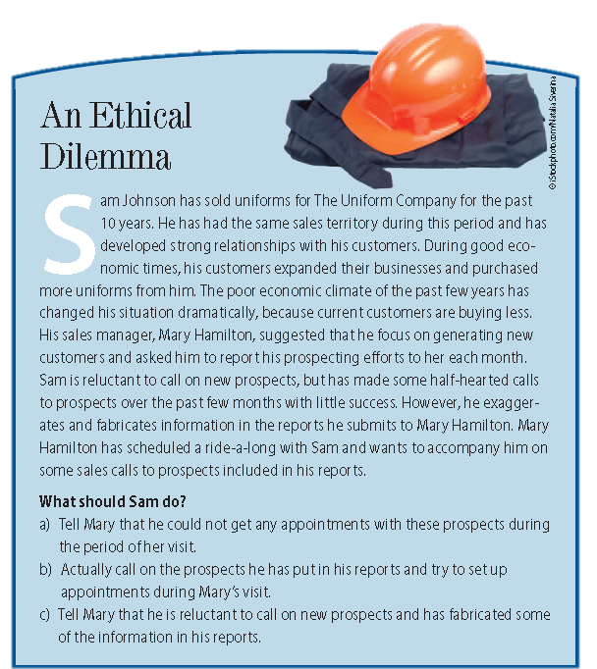
Ethical Dilemma

Slide 7
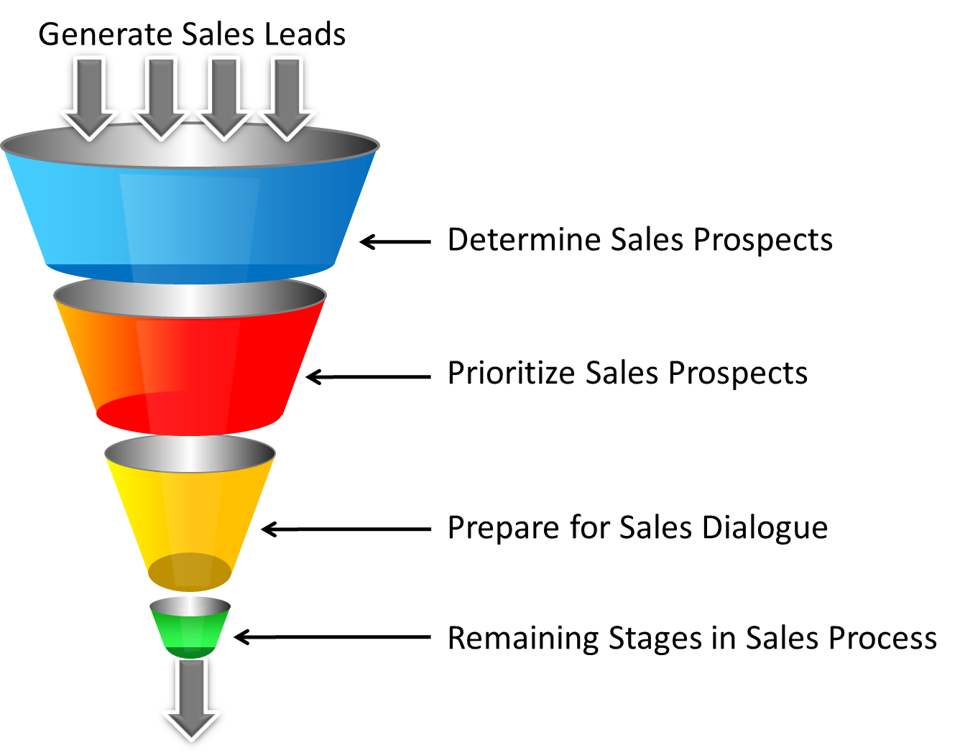
The Strategic Prospecting Process
Sales Funnel or Pipeline: A representation of the trust-based sales process and strategic sales prospecting process.

Slide 8
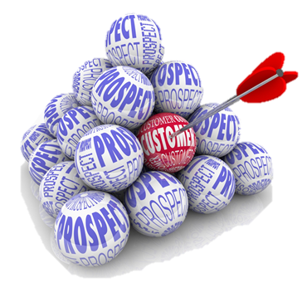
Strategic Prospecting Process
Sales Leads or Suspects
Qualifying Process
Sales Prospect
Need?
Financial Resources
Authority to Make Purchase Decision
Generated from Internal or External Sources
Lead Generation Methods Should be Managed
Initiate Pre-Call Planning
Prioritize Prospect List
Ideal Customer Profile: The characteristics of a firm’s best customers or the perfect customer.

Slide 9
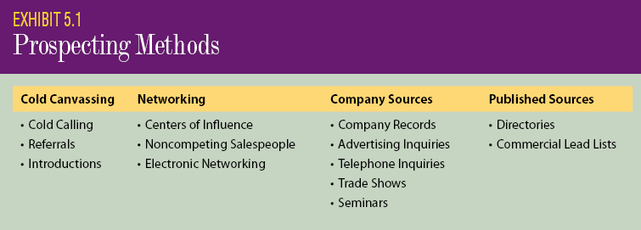
Popular Prospecting Sources & Methods
Basic purpose of strategic prospecting: To help salespeople determine the best sales opportunities in the most efficient way.

Slide 10
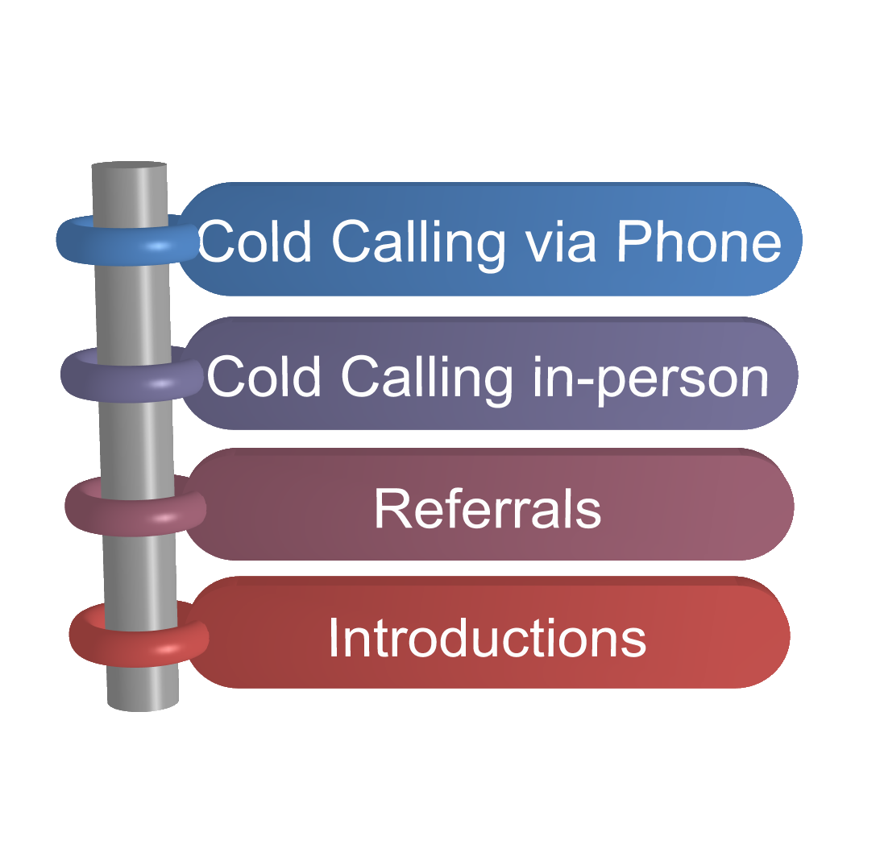

Cold Canvassing

Slide 11
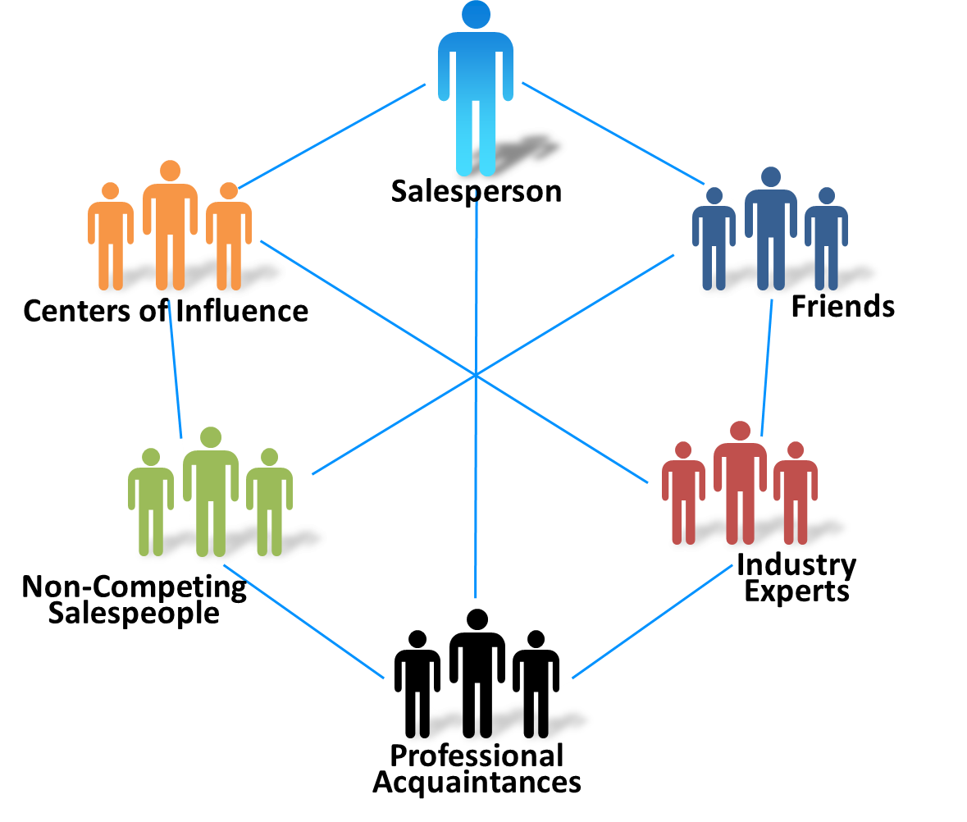
Networking

Slide 12

Company Sources
Company Records
Advertising Inquiries
Telephone Inquiries
Trade Shows
Seminars
Industry Trade Show in South Africa

Slide 13
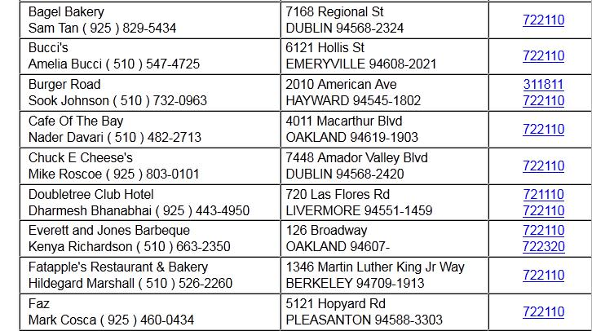
Published Sources
NAICS Code
Directories
Hoovers
Harris Directory
Moody’s industrial Directory
Commercial Lead Lists
Sales Genie
infoUSA
Others
Other Web Sources (including use of NAICS)

Slide 14
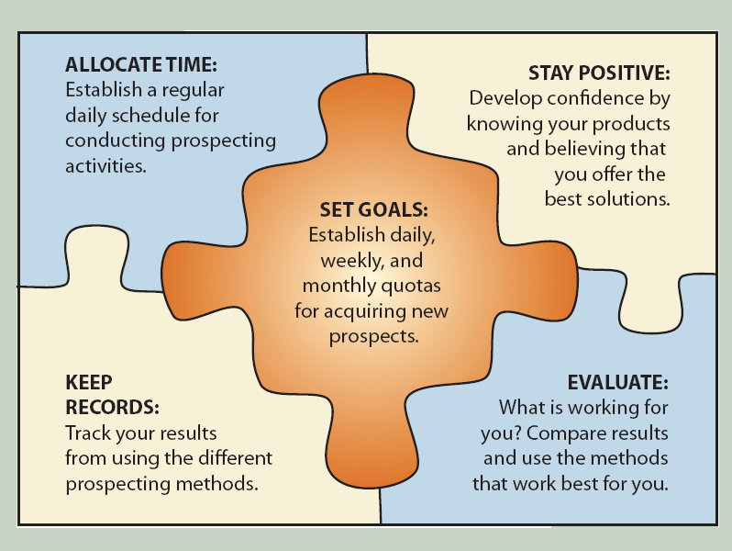
Developing a Strategic Prospecting Plan

Slide 15
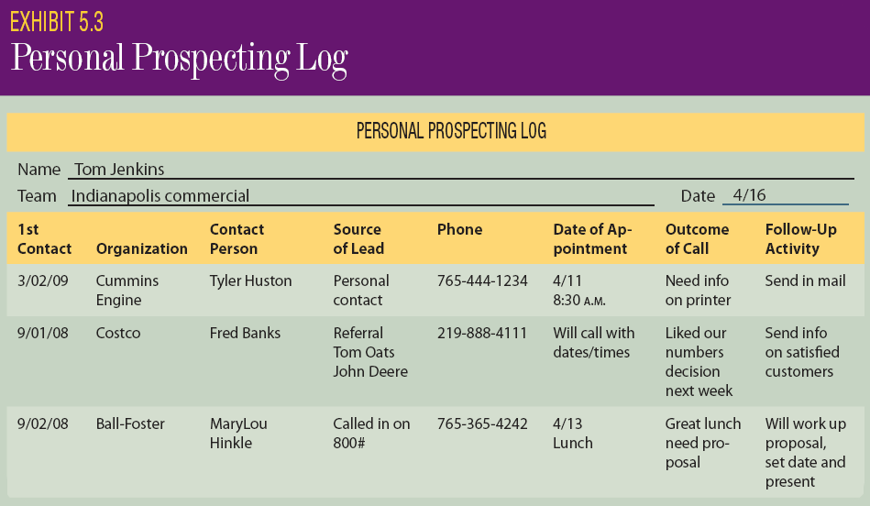
Developing a Strategic Prospecting Plan

Slide 16

Gathering Precall Information:
About the Buyer
Name, title and contact information
Education & work background
Community & organization involvement
Hobbies & interests
Communication style

Slide 17
Gathering Precall Information:
About the Company
Type of business
History of business
Current strategy & performance
Number of employees
Target markets served
Products & services offered
Key competitors

Slide 18
Gathering Precall Information:
About the Selling Situation
Type of purchase
Motivation for buying
Buying center members & roles
Buying process
Current supplier
Available budget
Competitors involved

Slide 19
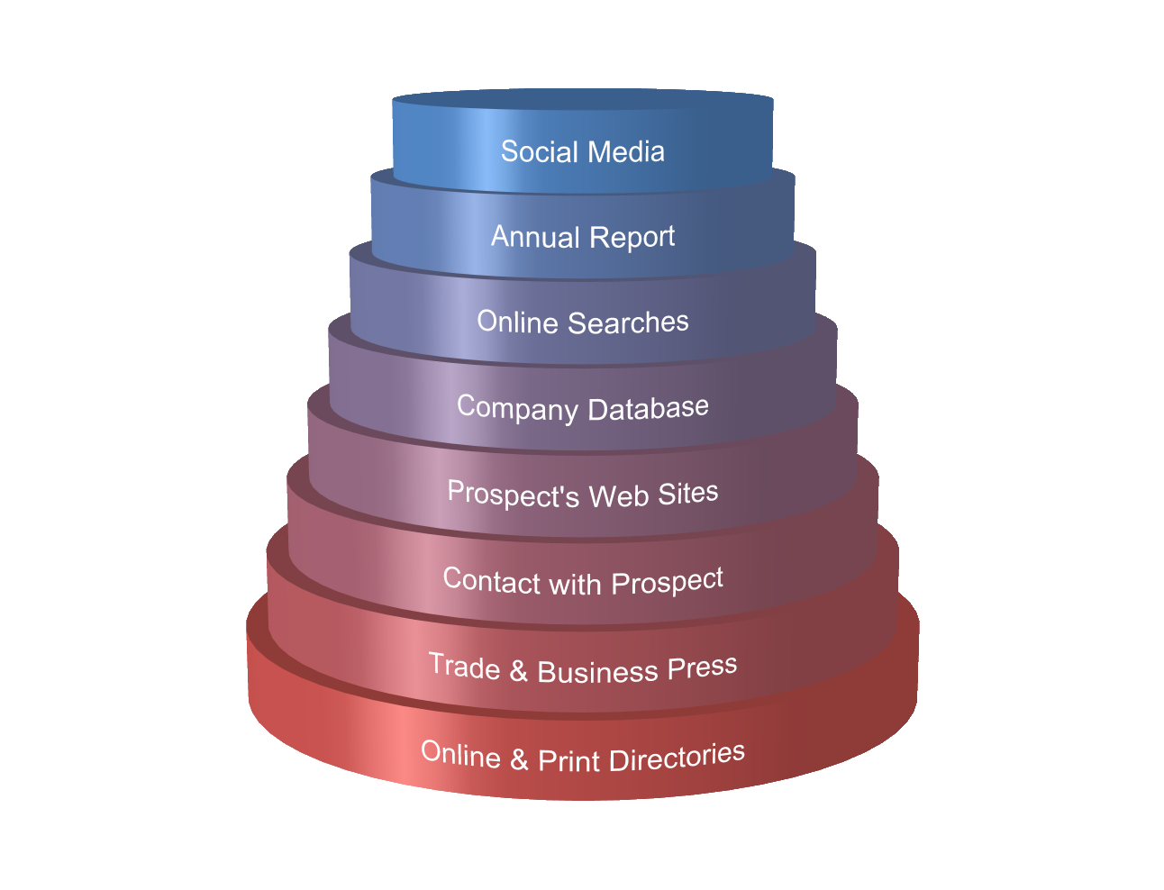

Sources of Information

Slide 20
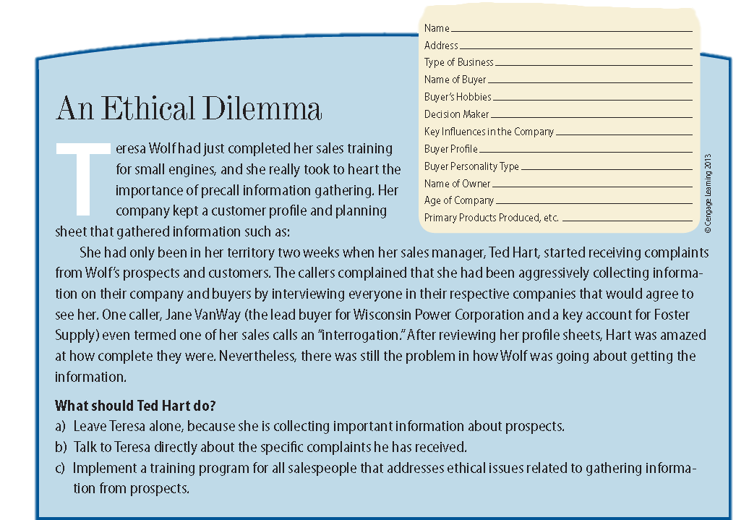
Ethical Dilemma

